Slide 1

Good morning :)

Slide 2


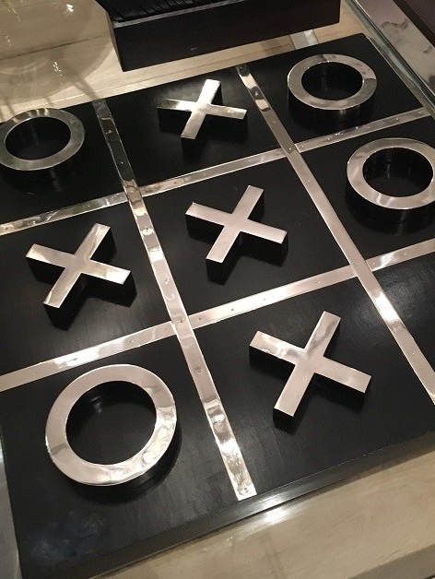
Oop2 course project:
Tic Tac Toe game
By: Elaf, Salma,&Mariam
Supervised by: T.Noor Hafsa

Slide 3

Part 1: introduction

Slide 4
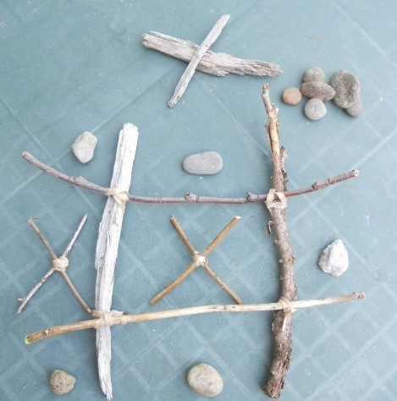

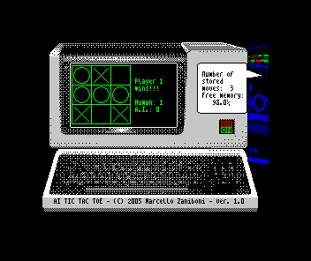
What is Tic Tac Toe??
Earliest
Small step
Now!!!

Slide 5


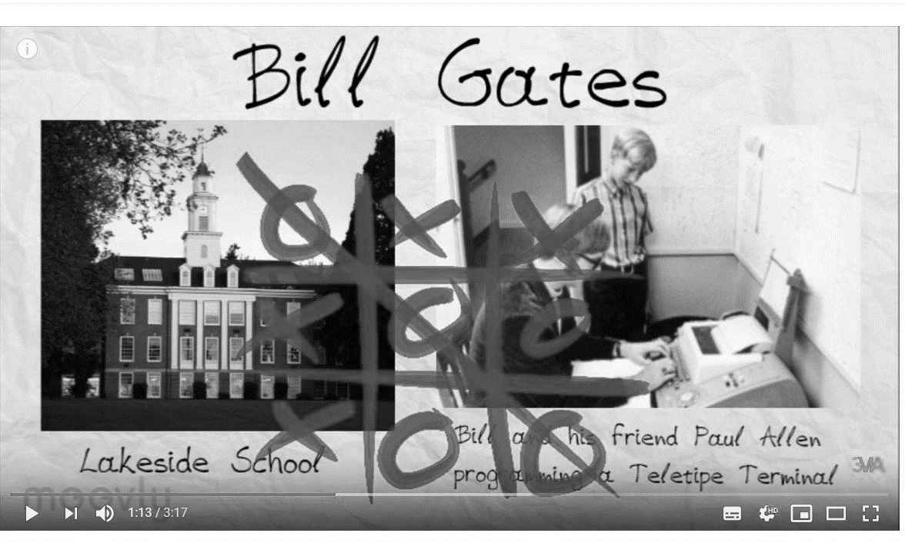
Why Tic Tac Toe??

Slide 6

Part 2: A journey through our game

Slide 7
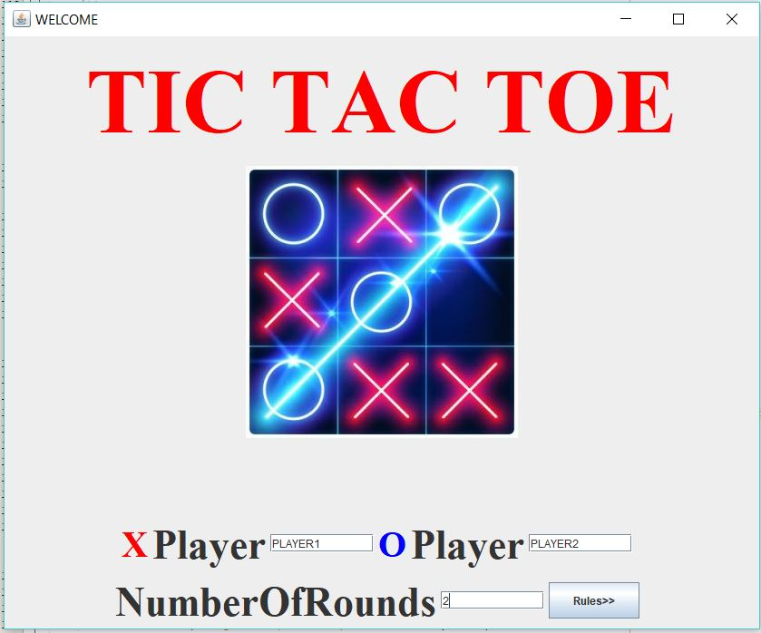
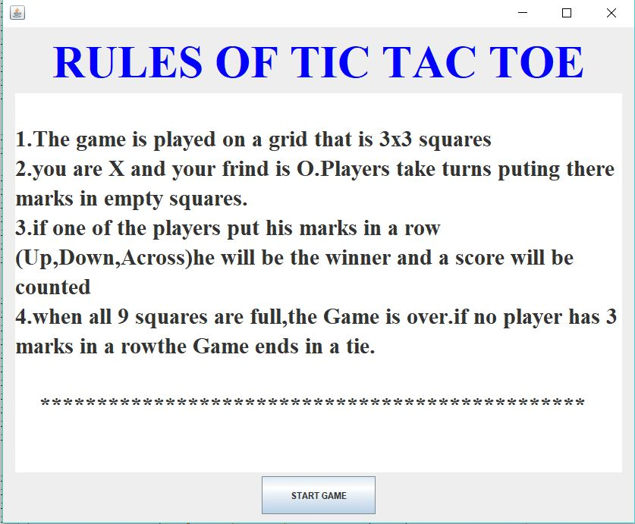
Before Playing…

Slide 8
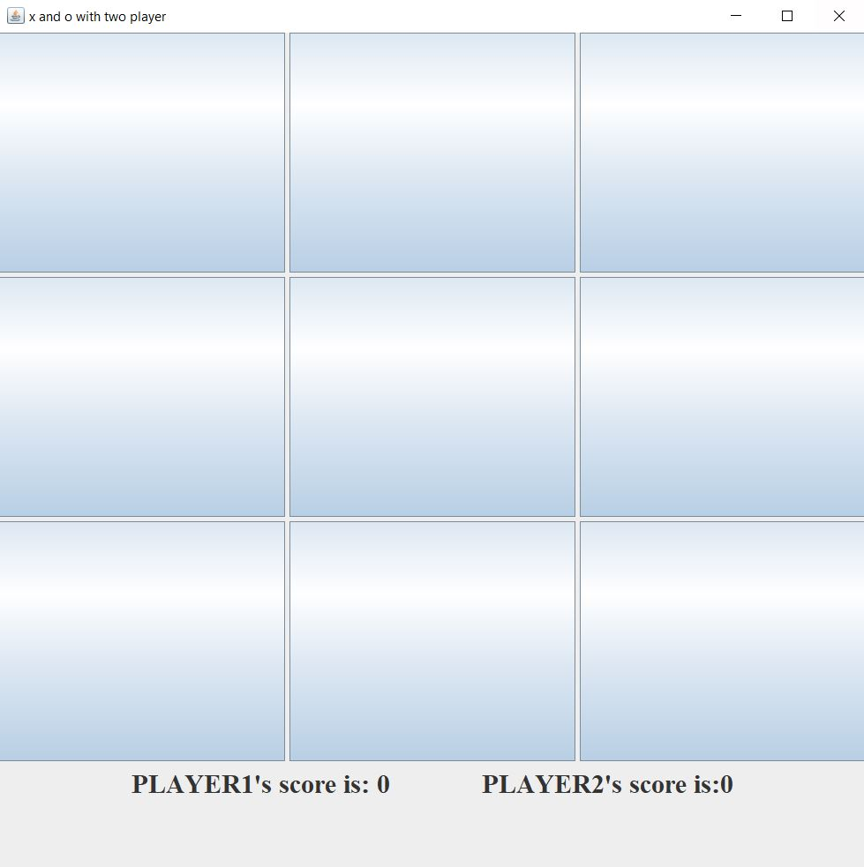
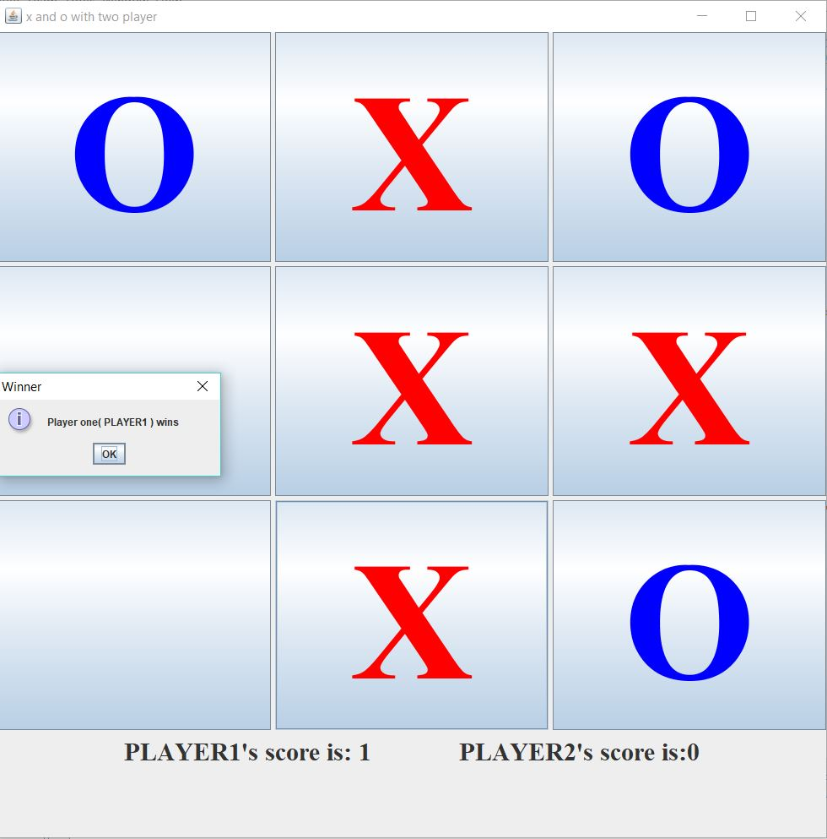
While Playing…

Slide 9
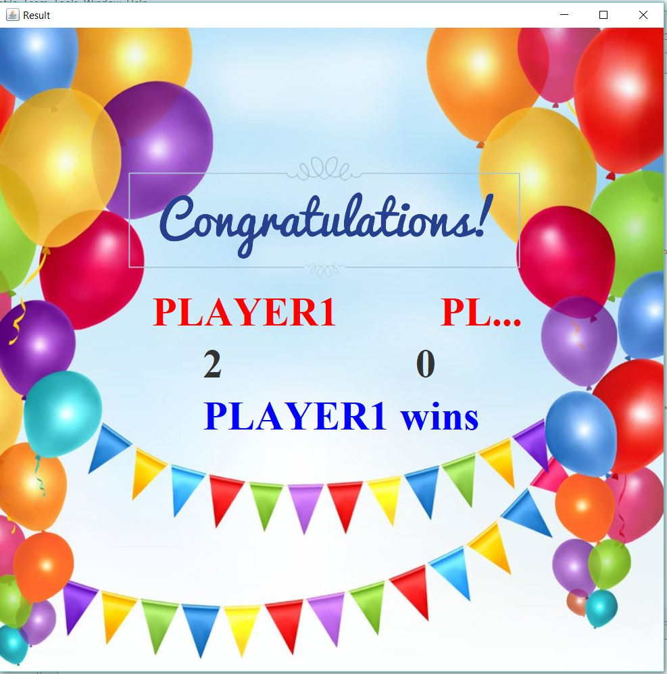
THE END OF THE GAME……

Slide 10
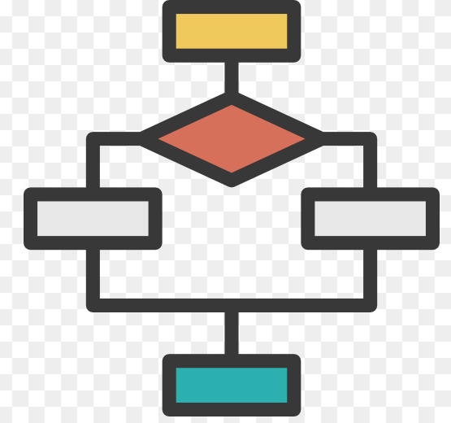
Part 3: Flow Chart

Slide 11
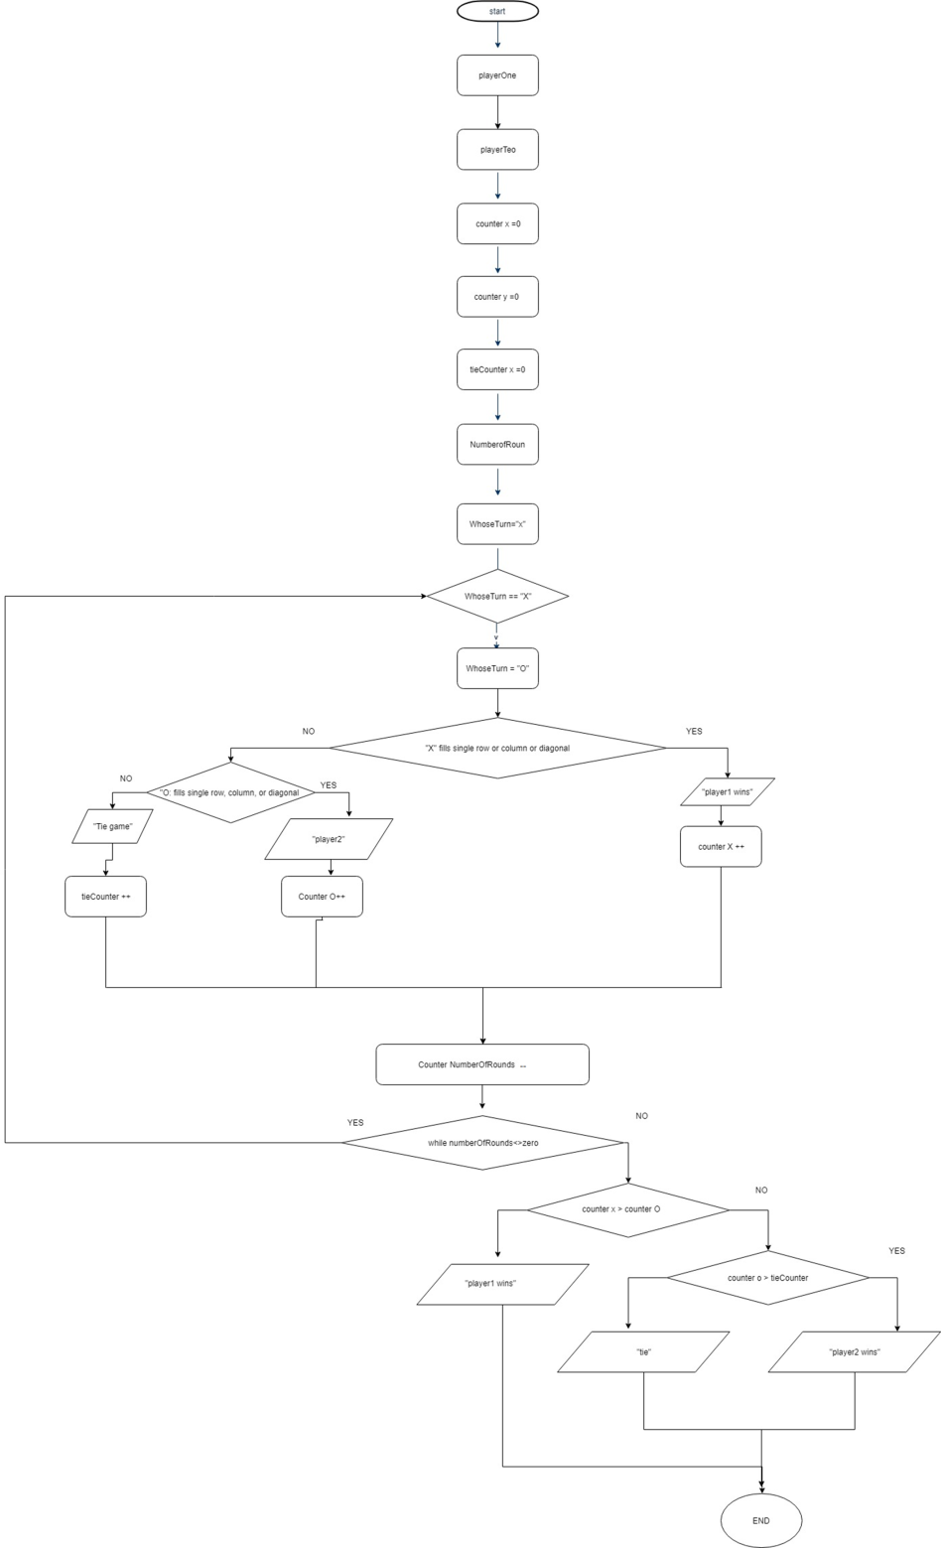
**Please reference to the
printout or the soft copy

Slide 12
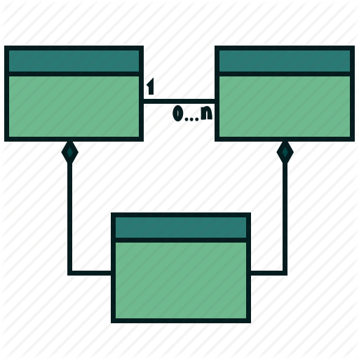
Part 4: UML

Slide 13
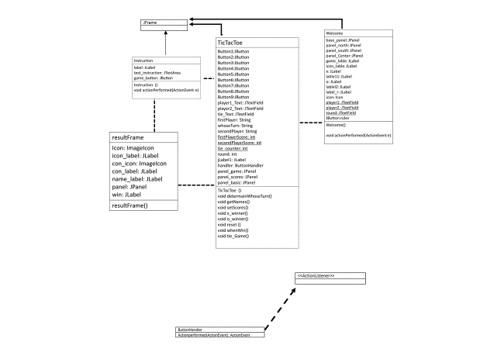
**Please reference to the printout or the soft copy

Slide 14

Part 5: Juint test

Slide 15
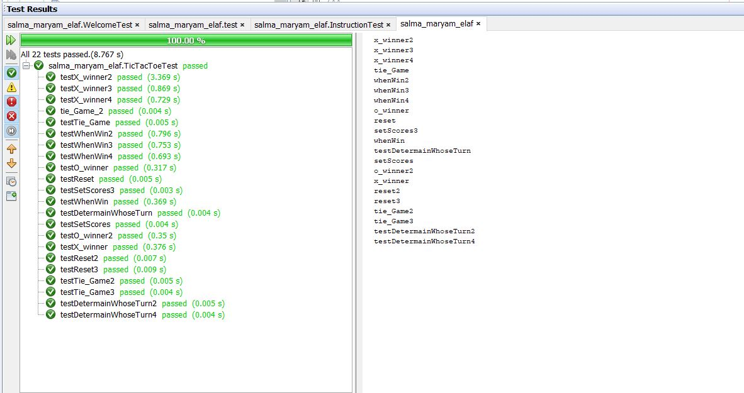
Yay!! It’s all perfect<3

Slide 16

Part 6: Roles

Slide 17
Elaf: The presentation
Salma: The UML and Flowchart
Mariam: The Junit test
`***Everyone participated in coding,
Designing,
and writing the report.***`

Slide 18
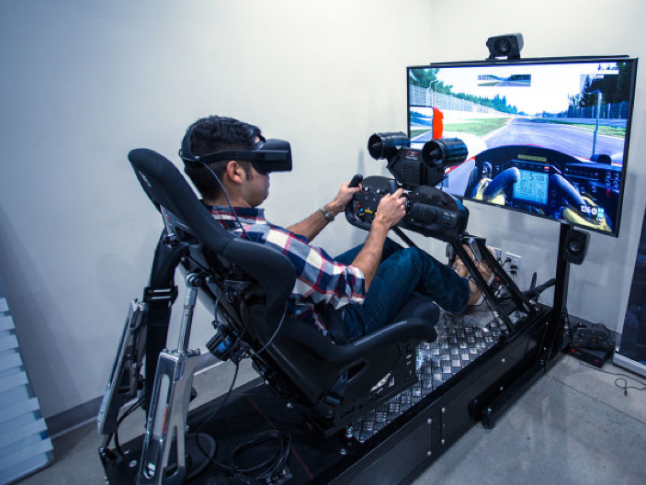
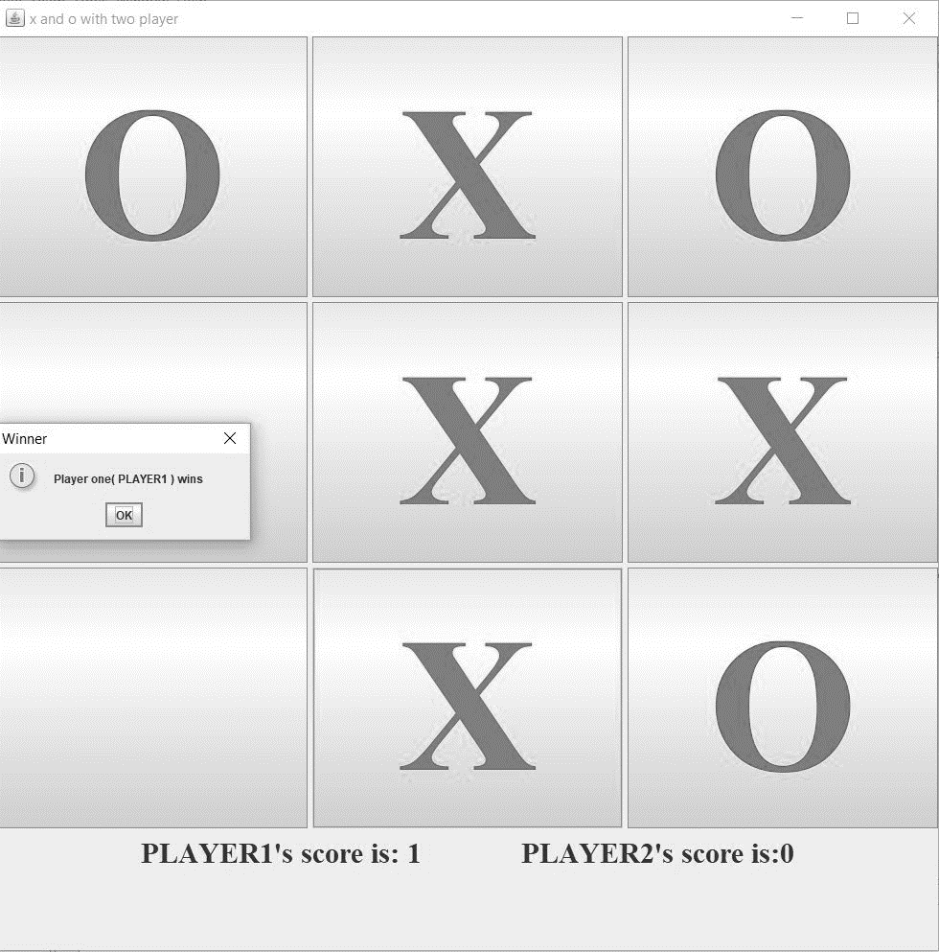
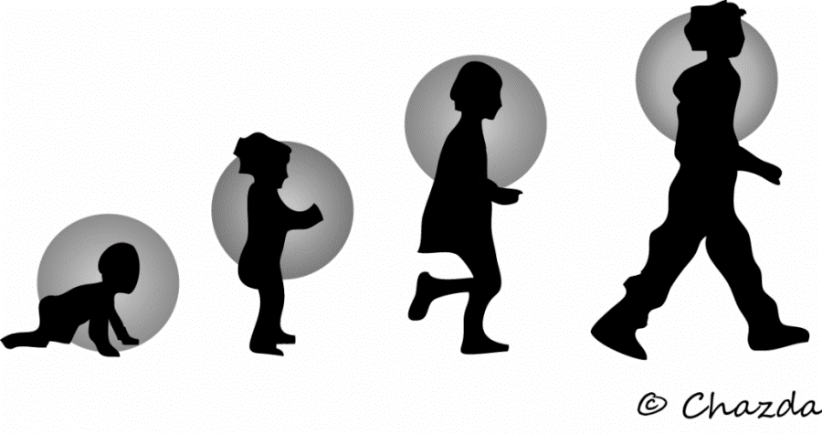

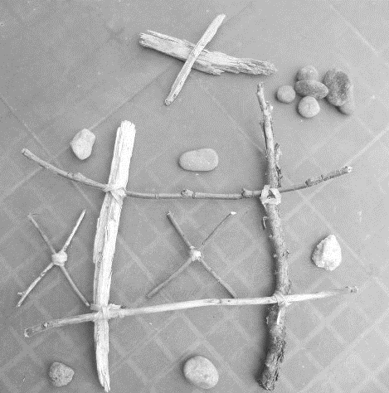
THNKS JAVA ..
THANKS TEACHER<3

Slide 19


